Slide 1

DATA MINING ON CLIMATE CHANGE DATASET
GROUP 5’S FINAL PROJECT
CS313 – Data Mining and Applications
Instructors: PhD. Vo Nguyen Le Duy
Wednesday, March 23rd, 2024

Slide 2
GROUP MEMBERS
#1
CHÂU THIÊN LONG - 21520331
#2
TĂNG MINH HIỂN - 21520229
#3
VÕ VIẾT THUẬN - 21521504
#4
NGUYỄN THÁI THÀNH LONG - 21520334
GROUP 5

Slide 3
TABLE OF CONTENTS
#1
INTRODUCTION
#4
RESULT ANALYSIS
#2
CLIMATE CHANGE
#5
LIMITATIONS
#3
METHODOLOGY
#6
CONCLUSION

Slide 4
#1
INTRODUCTION

Slide 5

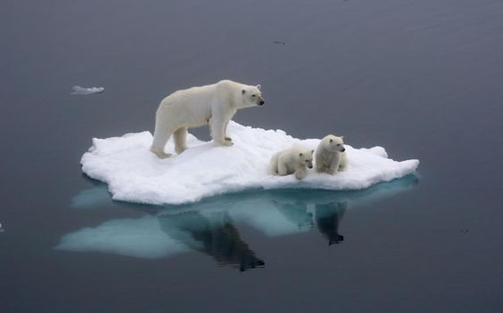
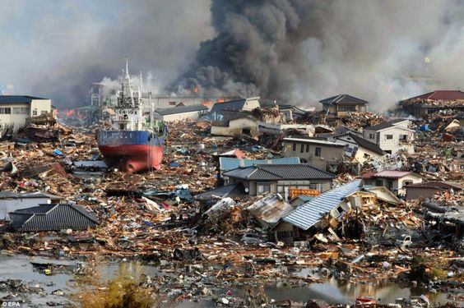
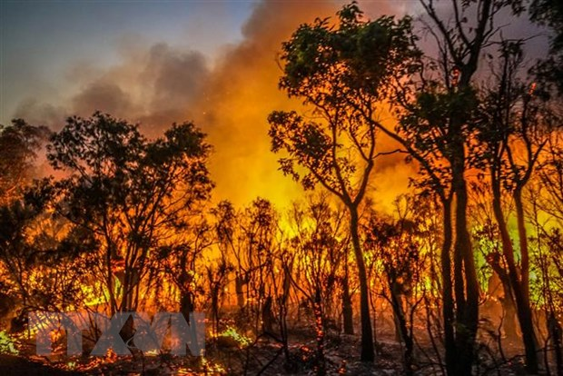
INTRODUCTION
Climate change has been becoming more and more severe
Fig 1. Flood
Fig 2. Melting ice
Fig 3. Disasters
Fig 4. Forest Fire

Slide 6
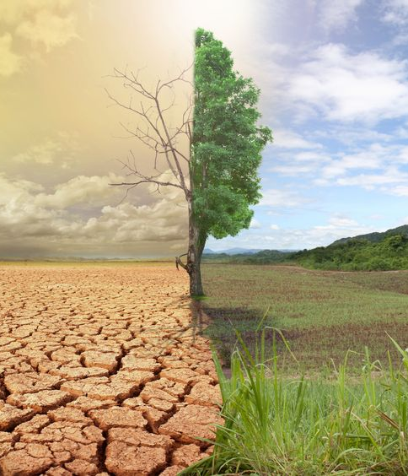
INTRODUCTION
In this projects
Apply data mining on a climate change-related dataset
Build predictive model
Conclude mitigations can be made to alleviate climate change

Slide 7
#2
CLIMATE CHANGE

Slide 8
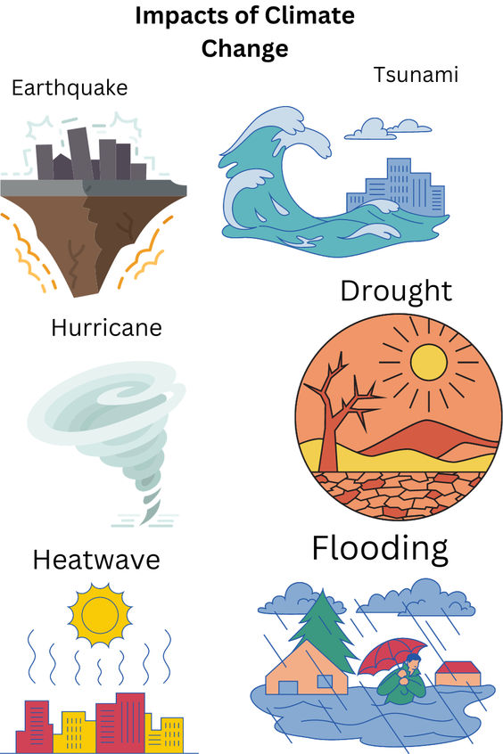
CLIMATE CHANGE
DEFINITION
What is Climate Changes?
Refers to long-term changes in temperatures and weather patterns causings by naturally factors.
Since the 1800s, human activities have become the primary driver of climate change, mainly through the burning of fossil fuels like coal, oil, and gas.
Fig 4. Impacts of Climate Changes

Slide 9
CLIMATE CHANGE
CURRENT SITUATION
How Climate Changes occurs now?
Tempeature of World is at least 1 degree Celsius above preindustrial level as of 2019.
2/3 of the world's cities are located in areas at risk of sea level rise.
Soil degradation affecting about 500 millions people and threatening 30% of food cultivated in the area.
Climate change strengthens natural disasters, causing more damage to infrastructure and inhabitants.

Slide 10
CLIMATE CHANGE
DATASET
What dataset used in this project?
Tempeature of World is at least 1 degree Celsius above preindustrial level (middle of 18th century) as of 2019.
2/3 of the world's cities are located in areas at risk of sea level rise.
Soil degradation, affecting about 500 millions people and threatening 30% of food cultivated in the area.
More number and strengthens natural disasters, causing more damage to infrastructure and inhabitants.

Slide 11
CLIMATE CHANGE
Data Collection (File type: .csv)
DATA NAME | SCOPE | COLLECTION FREQUENCY (TIME)
Surface Temperature | By countries | Yearly
CO2 Concentration | WorldWide | Monthly
Sea Level | By sea areas | Daily
Disaster frequency | By countries | Yearly
Energy transition | By regions | Yearly
Forestation | By countries | Yearly
Land coverage | By countries | Yearly
Greenhouse gases | By regions | Quarterly
El Niño | WorldWide
La Niña | WorldWide

Slide 12
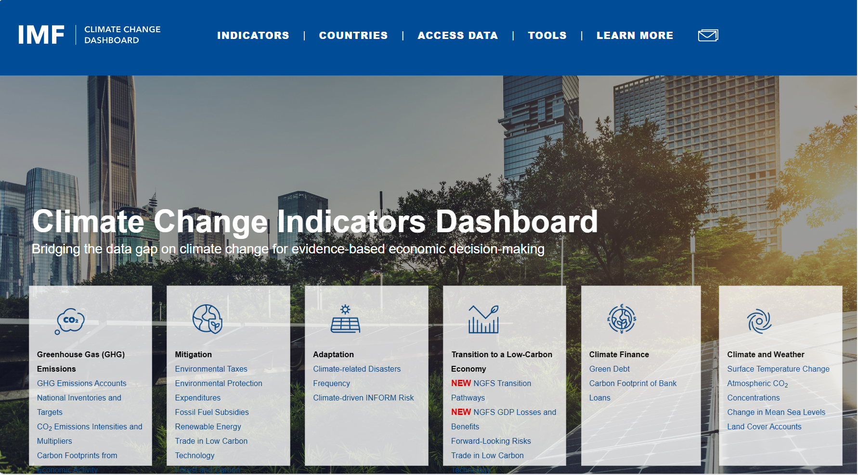
CLIMATE CHANGE
DATASET
What dataset used in this project?
Fig 5. IMF Climate Change Dashboard dataset (source: https://climatedata.imf.org/)

Slide 13
#3
METHODOLOGY
EXPLORATORY ANALYSIS
MINING USEFUL INFORMATION
PREDICTIVE MODELS

Slide 14
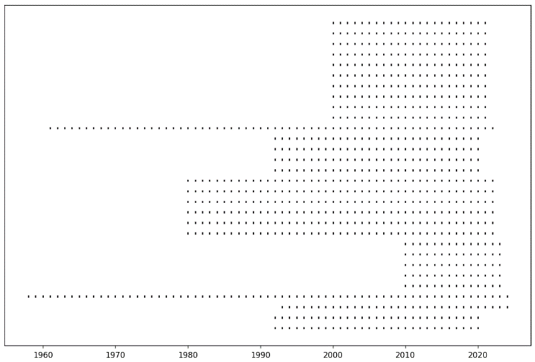
METHODOLOGY
EXPLORATORY ANALYSIS
Deal with Wide scope of region and time data
Availability of data of each feature in each year.

Slide 15
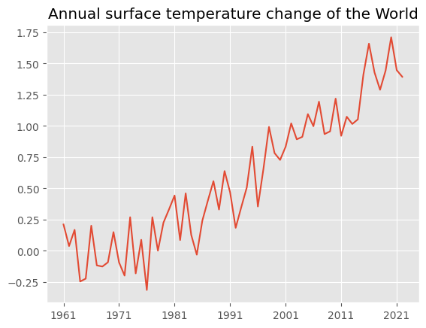
METHODOLOGY
EXPLORATORY ANALYSIS
From the 1980s, the Earth's surface temperature slowly increased, overlapped with the Third Industrial Revolution.
The rate has been becoming faster and faster lately and reached the peak in the past ten years.
Worldwide surface temperature change compared to a baseline in the 1960s. (unit: degree Celsius)

Slide 16
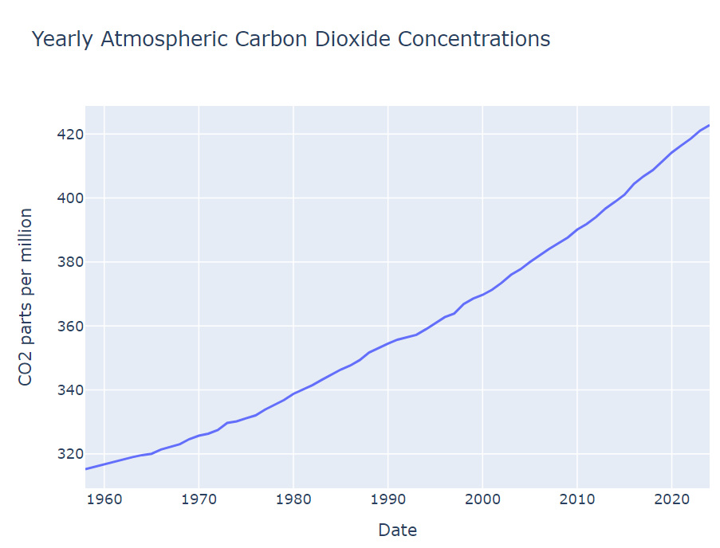
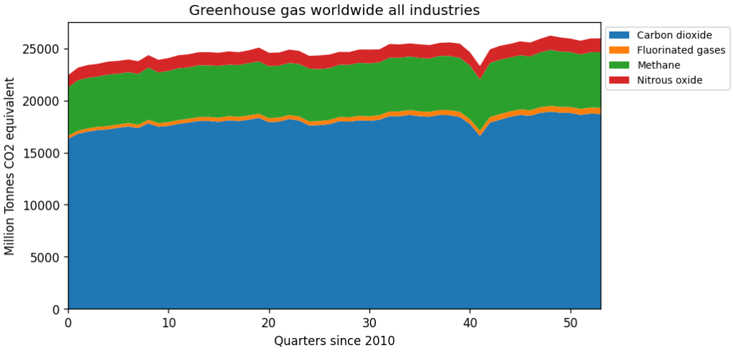
METHODOLOGY
EXPLORATORY ANALYSIS

Slide 17
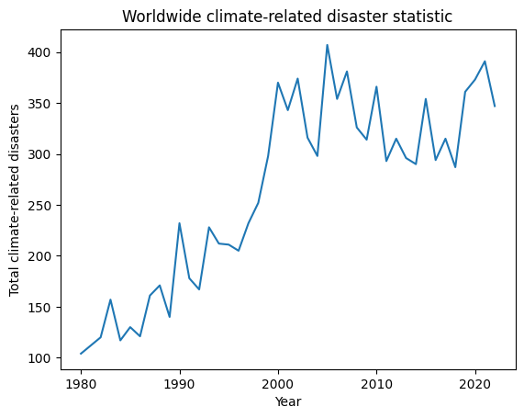
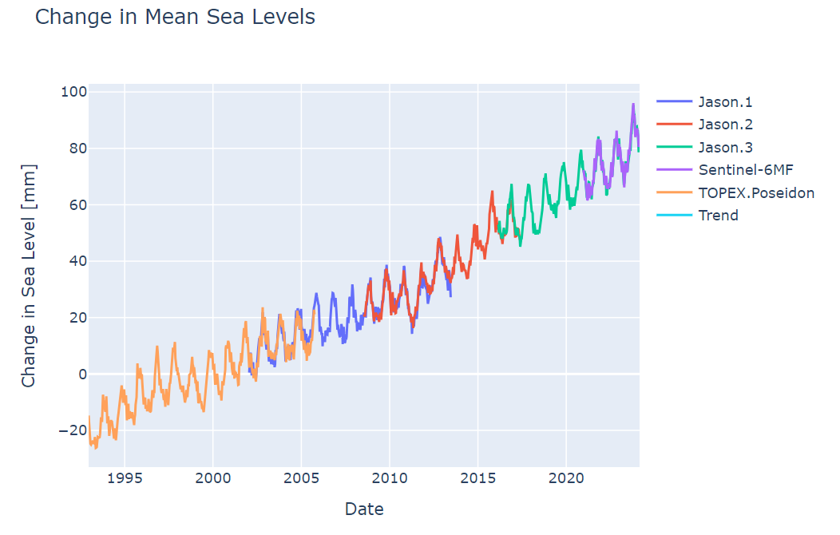
METHODOLOGY
EXPLORATORY ANALYSIS

Slide 18
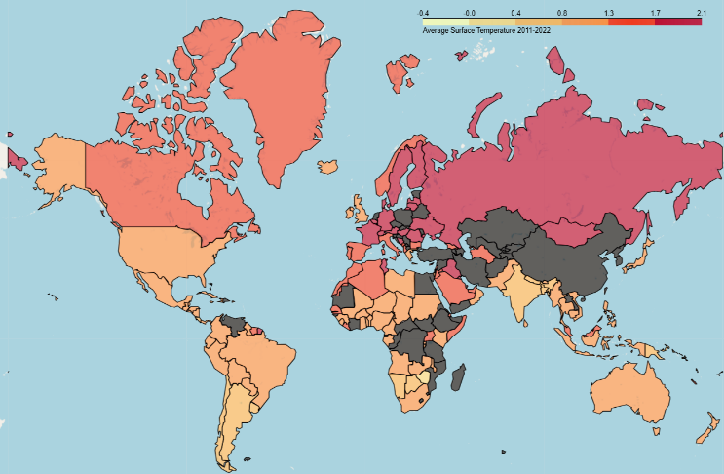
METHODOLOGY
EXPLORATORY ANALYSIS
It can be observed that most countries near the North Pole have significantly increased surface temperatures
Also, Antarctica is surrounded by the Antarctic circumpolar and Antarctic subpolar current. Thus maintains the ocean temperature better.
Average surface temperature of each country from 2011 to 2022

Slide 19
METHODOLOGY
MINING USEFUL INFORMATION
ANOMALY DETECTION
Detect unusual cased appear in data and try to catch why it appear
CORRELATION COEFFICIENT
Understanding of relations between features across different lags

Slide 20
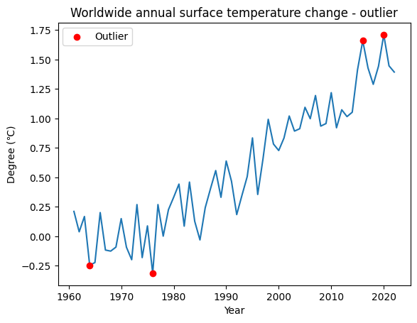
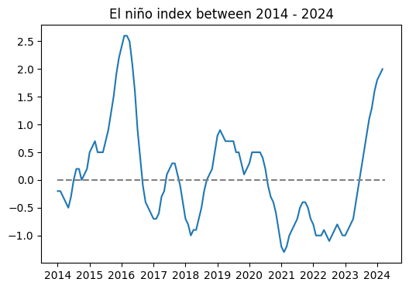
METHODOLOGY
MINING USEFUL INFORMATION – ANOMALY DETECTION

Slide 21
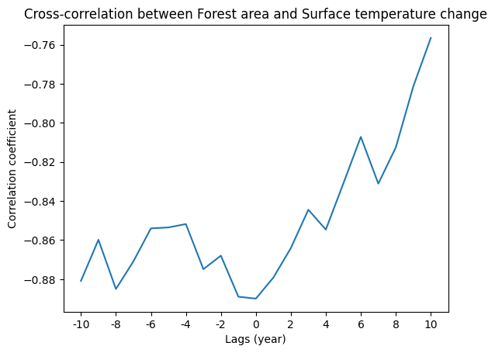
METHODOLOGY
MINING USEFUL INFORMATION – CORRELATION COEFFICIENT

Slide 22
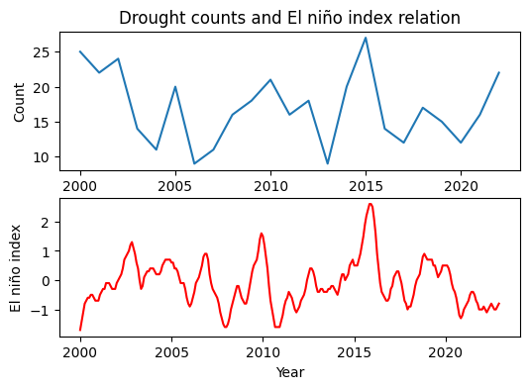
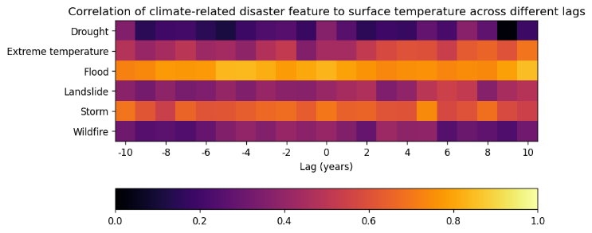
METHODOLOGY
MINING USEFUL INFORMATION – CORRELATION COEFFICIENT

Slide 23
METHODOLOGY
PREDICTIVE MODELS – LIST OF MODELS
ARIMA MODELS
Autoregressive Integrated Moving Average – Statistical models
LINEAR REGRESSION
Simple regression models
LONG-SHORT TERM MEMORY
Recurrent Neural networks architecture with long term dependencies

Slide 24
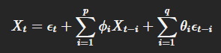
METHODOLOGY
Xt=ϵt+∑i=1pϕiXt−i+∑i=1qθiϵt−i𝑋𝑡=𝜖𝑡+∑𝑖=1𝑝𝜙𝑖𝑋𝑡−𝑖+∑𝑖=1𝑞𝜃𝑖𝜖𝑡−𝑖
PREDICTIVE MODELS – LIST OF MODELS
ARIMA MODELS
Autoregressive Integrated Moving Average – Statistical models
1. Autoregressive (AR): How predictions is calculated
2. Integrated (I): Differencing the data to achieve stationarity.
3. Moving Average (MA): Uses past forecast errors to predict future values.
COMPONENTS:
p – window of the AR, q – window of the MA and d – order of differencing.
HYPERPARAMETERS:
FORMULA:

Slide 25
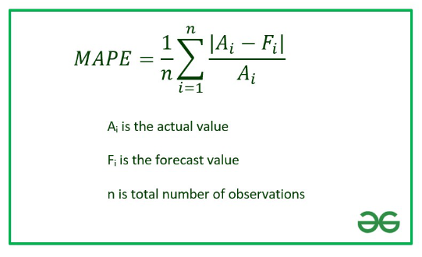
METHODOLOGY
Xt=ϵt+∑i=1pϕiXt−i+∑i=1qθiϵt−i𝑋𝑡=𝜖𝑡+∑𝑖=1𝑝𝜙𝑖𝑋𝑡−𝑖+∑𝑖=1𝑞𝜃𝑖𝜖𝑡−𝑖
PREDICTIVE MODELS – LIST OF MODELS
ARIMA MODELS
Autoregressive Integrated Moving Average – Statistical models
METRICS:
Mean Absolute Percentage Error (MAPE): used to assess the accuracy of a forecasting model by quantifying the average magnitude of errors as a percentage of the actual values.
This metrics apply to ARIMA models with n specific data points to evaluate the model.
Fig 6. Mean Absolute Percentage Error (MAPE) formula

Slide 26
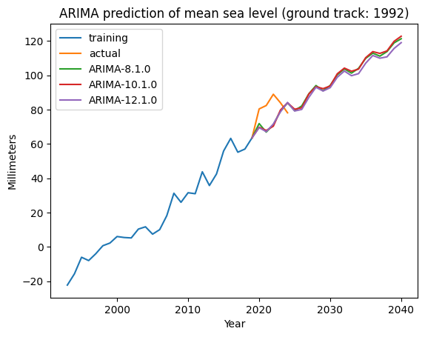
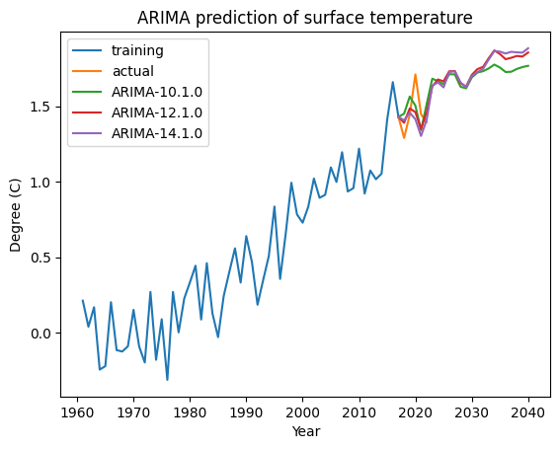
METHODOLOGY
PREDICTIVE MODELS – EXPERIMENTS

Slide 27
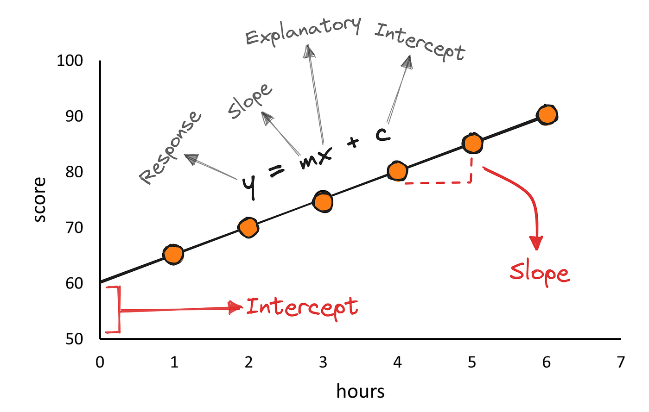
METHODOLOGY
PREDICTIVE MODELS – LIST OF MODELS
LINEAR REGRESSION
Simple regression models
Pipeline:
Remove features that have low correlation with each other
Use model with default settings of sklearn library
Fig 7. Linear Regresison

Slide 28
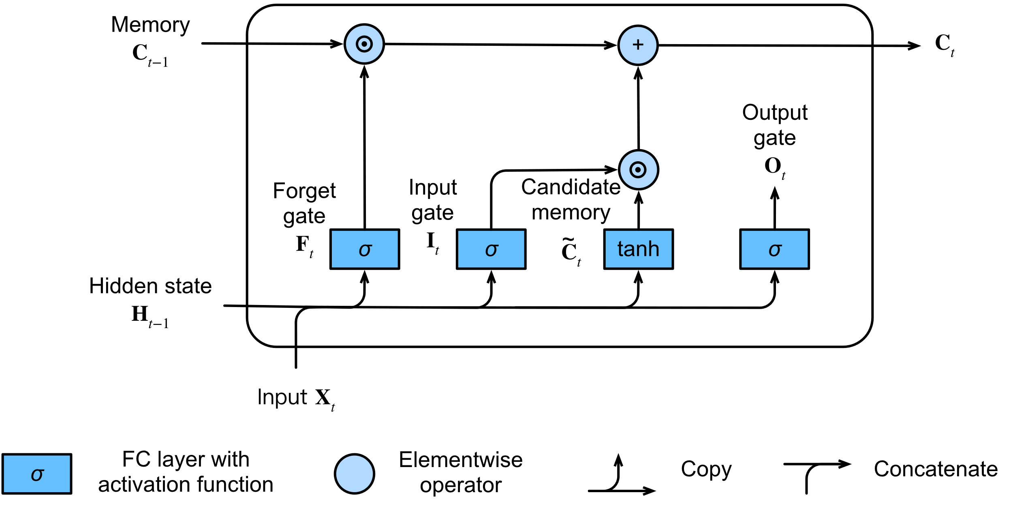
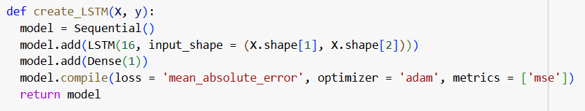
METHODOLOGY
PREDICTIVE MODELS – LIST OF MODELS
LONG-SHORT TERM MEMORY
Recurrent Neural networks architecture with long term dependencies
Hyperparametes:
Same pipeline with Linear Regression
Fig 8. Long Short-Term Memory Architecture

Slide 29
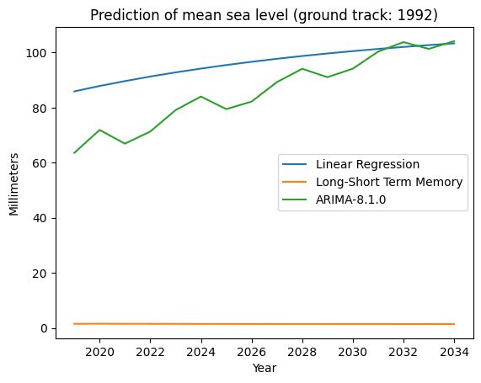
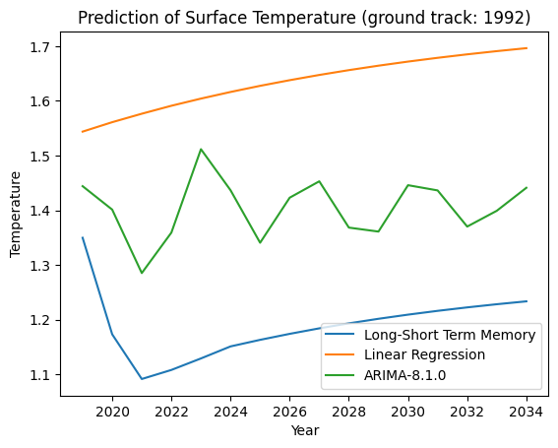
METHODOLOGY
PREDICTIVE MODELS – EXPERIMENTS

Slide 30
#4
RESULT ANALYSIS

Slide 31
RESULT ANALYSIS
INTERPRETATION
Main content
Provide insight information
POSSIBLE MITIGATIONS
Some solutions to improve climate change situation

Slide 32
RESULT ANALYSIS
INTERPRETATION
Provide insight information
Climate change is happening, and it is tend to happen into most worst situations.
El Niño is a common climate phenomenon, but it has a good synergy with climate change, which will amplify the effects of climate change in a much worse way. Example, the two previous years that have extremely high temperatures, 2016 and 2019, are the result of amplification of El Niño in conjunction with climate change.
Natural disasters are strongly associated with El Niño rather than climate change, but some evidence suggests that climate change is also a main factor that strengthens El Niño event. Stronger El Niño effect creates more catastrophic disasters
Climate change increases the ocean temperature, which causes the ice in the polar melts, which will threaten the habitat of many animals and also flood many coastal areas in the world.

Slide 33
RESULT ANALYSIS
POSSIBLE MITIGATIONS
Some solutions to improve climate change situation
Advanced in environmental-friendly science introduces many technologies that use renewable resources which do not or emit at low rate greenhouse gases. Forests play an important role in regulating CO2 concentration. Therefore, it is necessary to recover the forest area. Lack of forests also leads to devastating floods that damage the life of local habitat.
As some industries require emitting large amounts of CO2 as a by-product, developing artificial carbon sinks can help reduce the emission amount significantly.
Other methods have also been proposed to capture CO2 in the atmosphere or industrial waste to process and use again or safely store.

Slide 34
#5
LIMITATIONS

Slide 35
LIMITATIONS
LIMITS OF OUR PROJECT
Worked only data on worldwide data, not fully address the cases to better study how climate change impacts each region individually, as well as predict the trends in regions.
In addition, the El Niño index dataset is evidently interesting information from which we did not fully benefit.
More techniques can be used to gain a deeper insight into climate change.
The IMF dataset provides contains low resolution time series. We can actively collect data from many sources to enhance dataset to improve the predictive models and get more insights information.

Slide 36
REFERENCES

Slide 37
REFERENCES
Documents:
[1] International Monetary Fund. 2022.Climate Change Indicators Dashboard. Accessed on [2024-04-25]
[2] Ghosh, I. (Feb 9, 2021), Since 1850, these historical events have accelerated climate change, in collaboration with Visual Capitalist. World Economic Forum.
[3] History.com Editors, (October 6, 2017), Climate Change History, (last updated, June 9, 2023). HISTORY. A&E Television Networks. Accessed on [2024-05-18]
[4] Alokya, K., (July 18, 2023). The Green Dilemma: Can AI Fulfil Its Potential Without Harming the Environment?, Earth.org, Access on [2024-05-18]
[5] United Nations, The Climate Crisis – A race we can win, un.org, Access on [2024-05-19]
[6] Sarah, F. (February 25, 2021), How Exactly Does Carbon Dioxide Cause Global Warming?, State of the Planet, Columbia Climate School, Access on [2024-05-20]
[7] Understanding Global Warming Potentials, epa.gov, United States Environment Protection Agency, Access on [2024-05-21]
[8] Matthew, H., (February 11, 2022). “Why does the Arctic warm faster than the rest of the planet?”, carbonbrief.org, Access on [2024-05-20]
[9] United Nations. “What is Climate Change?”, un.org, Access on [2024-05-20]
[10] Rebecca, H., “Why Europe is the fastest-warming continent on Earth”, npr.org, Access on [2024-05-20]
[11] Curry, J. A., Schramm, J. L., & Ebert, E. E. (1995). Sea ice-albedo climate feedback mechanism. Journal of Climate, 8(2), 240-247.
[12] Laine, V. (2007). Antarctic ice albedo, temperature and sea ice concentration trends, 1981-2000. In Annals of 2007 EUMETSAT Meteorological Satellite Conference and 15th AMS Conference, Amsterdam, The Netherlands (p. 50).
[13] Kimutai, J, Zachariah, M, Nhantumbo, B, Nkemelang, T, et al., (2024), El Niño key driver of drought in highly vulnerable Southern African countries, Royal Netherlands Meteorological Institute, Grantham Institute, Imperial College London, UK
[14] Prabhat, P., (Apr, 2024), Building an ARIMA Model for Time Series Forecasting in Python, Analytic Vidhya, Access on [2024-05-21]
[15] Bill, MG., (Dec, 2023), The point of no return: how close is the world to irreversible climate change?, Scientists for Global Responsibility, Responsible Science Journal, no. 6.
[16] Michael, M., (July, 2023), Has climate change already affected ENSO?, Science & Information for a climate-smart nation.

Slide 38

PROJECT WORK
Link main projects:
https://drive.google.com/drive/folders/15Dy4rnq97kGrOnobE1znPX1oussvbDa5?usp=drive_link

Slide 39
WORK SPLITTING TABLE
GROUP 5
MEMBER – ID | WORK | FINISH (%)
Châu Thiên Long 21520331
Tăng Minh Hiển 21520229
Võ Viết Thuận 21521504
Nguyễn Thái Thành Long 21520334

Slide 40
THANKS FOR LISTENING
CREDITS: This presentation template was created by Slidesgo, and includes icons by Flaticon and infographics & images by Freepik
Presentation slide is copyright of Group 5

